Slide 1


EDA on suicide Data
Submitted by
Shrikant Narayankar

Slide 2
1. Problem Statement
Suicide's are going all over world. however we have to prevent this.
We have to analyse the factors, which are affecting suicide rate?
Data given is 1986 to 2016

Slide 3
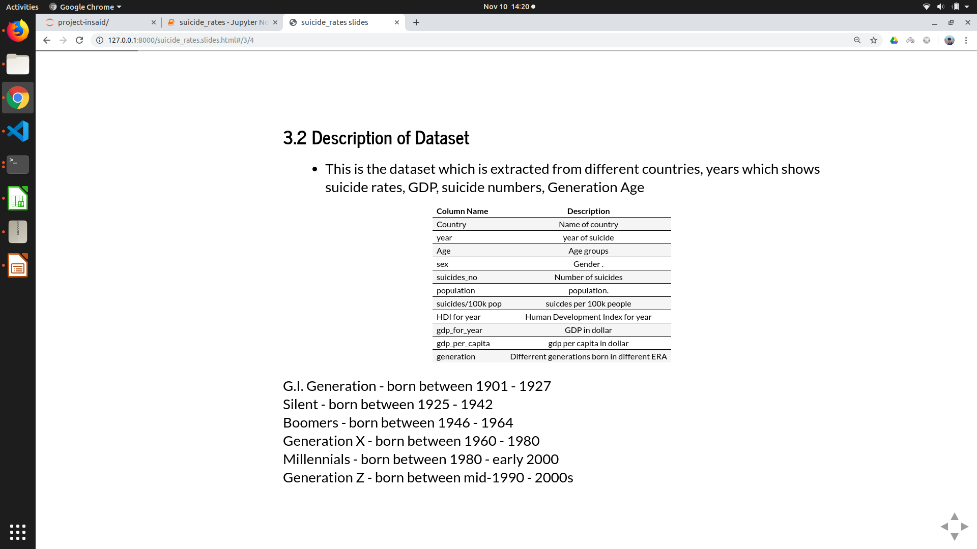

Slide 4
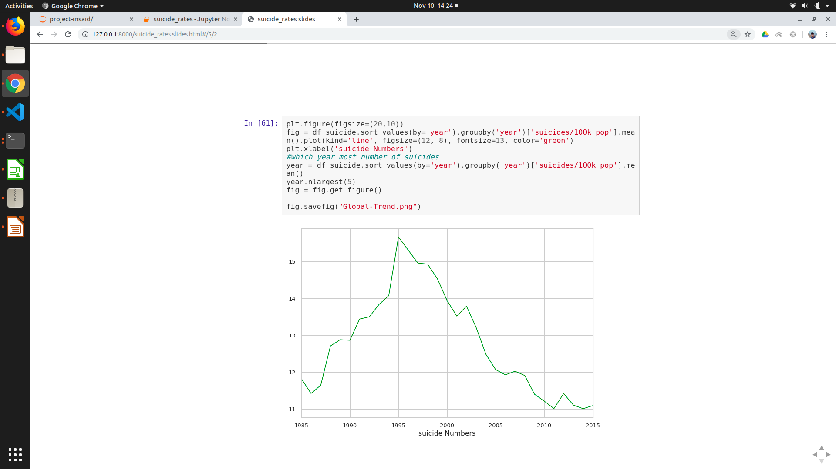
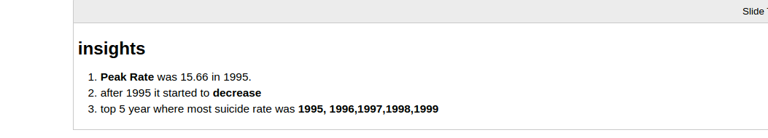
Global Trend of suicide per year

Slide 5
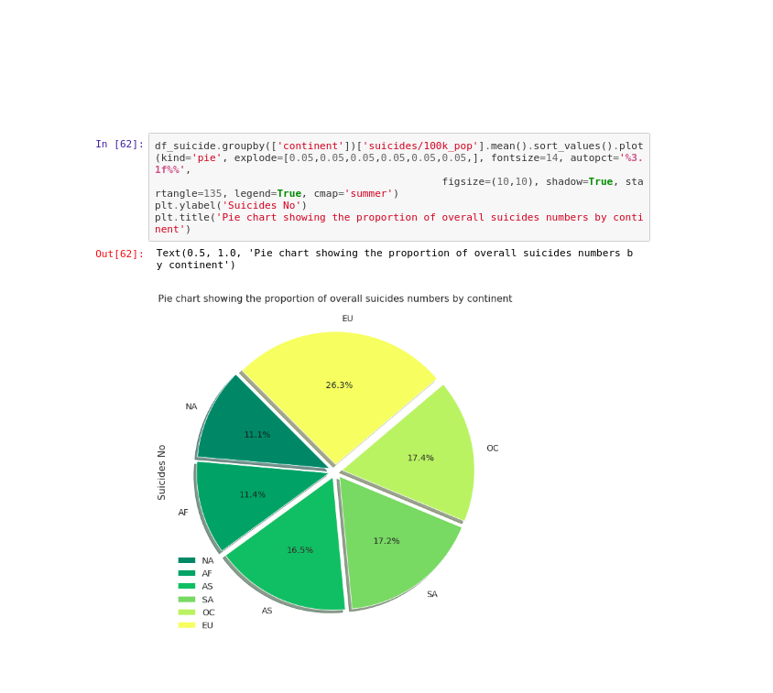
Suicide rate by continent

Slide 6
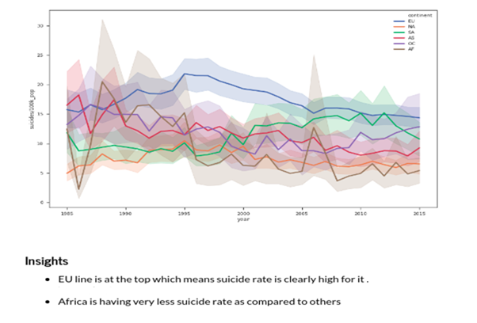
Suicide rate per year by continent

Slide 7
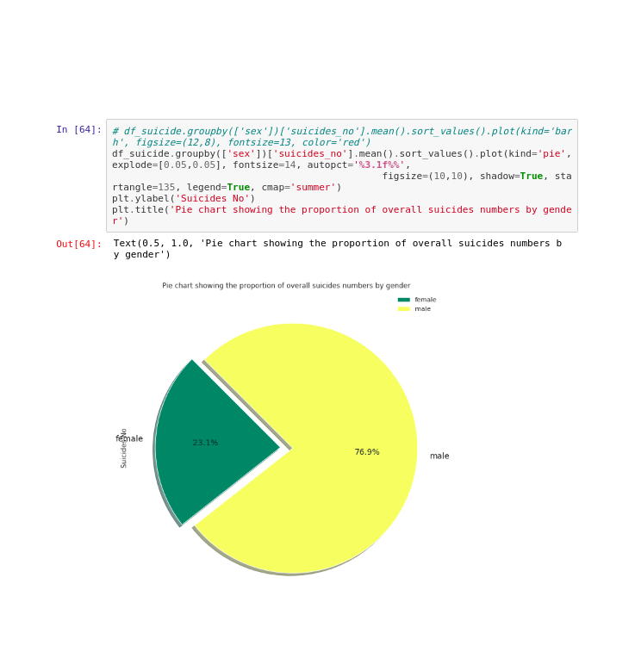
Suicide Rate distribution By Gender

Slide 8
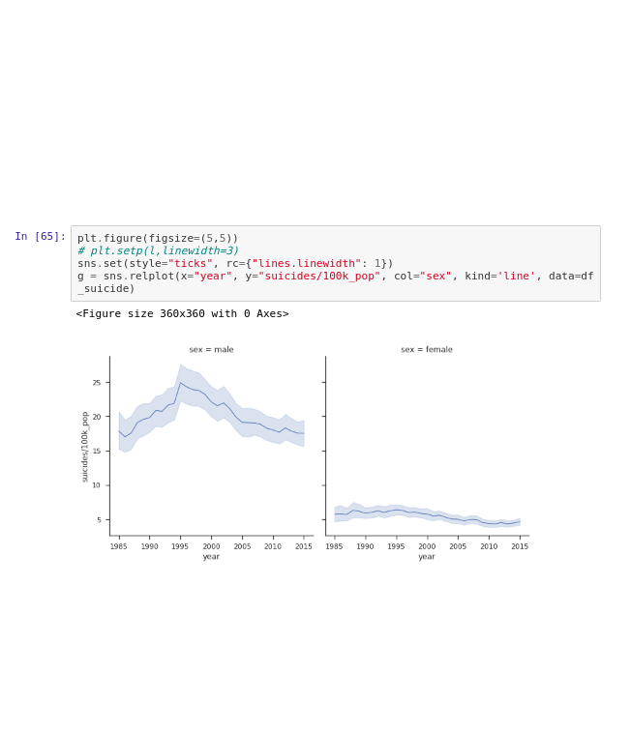
Suicide rate per year by gender
Insights - Men have greater suicide rate than Females - both suicide rate's started decreasing after 1995

Slide 9
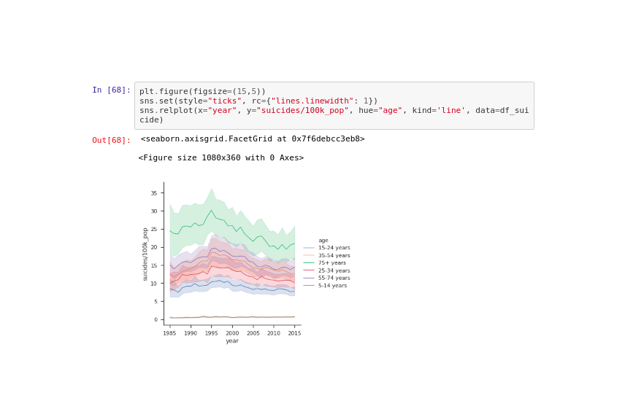
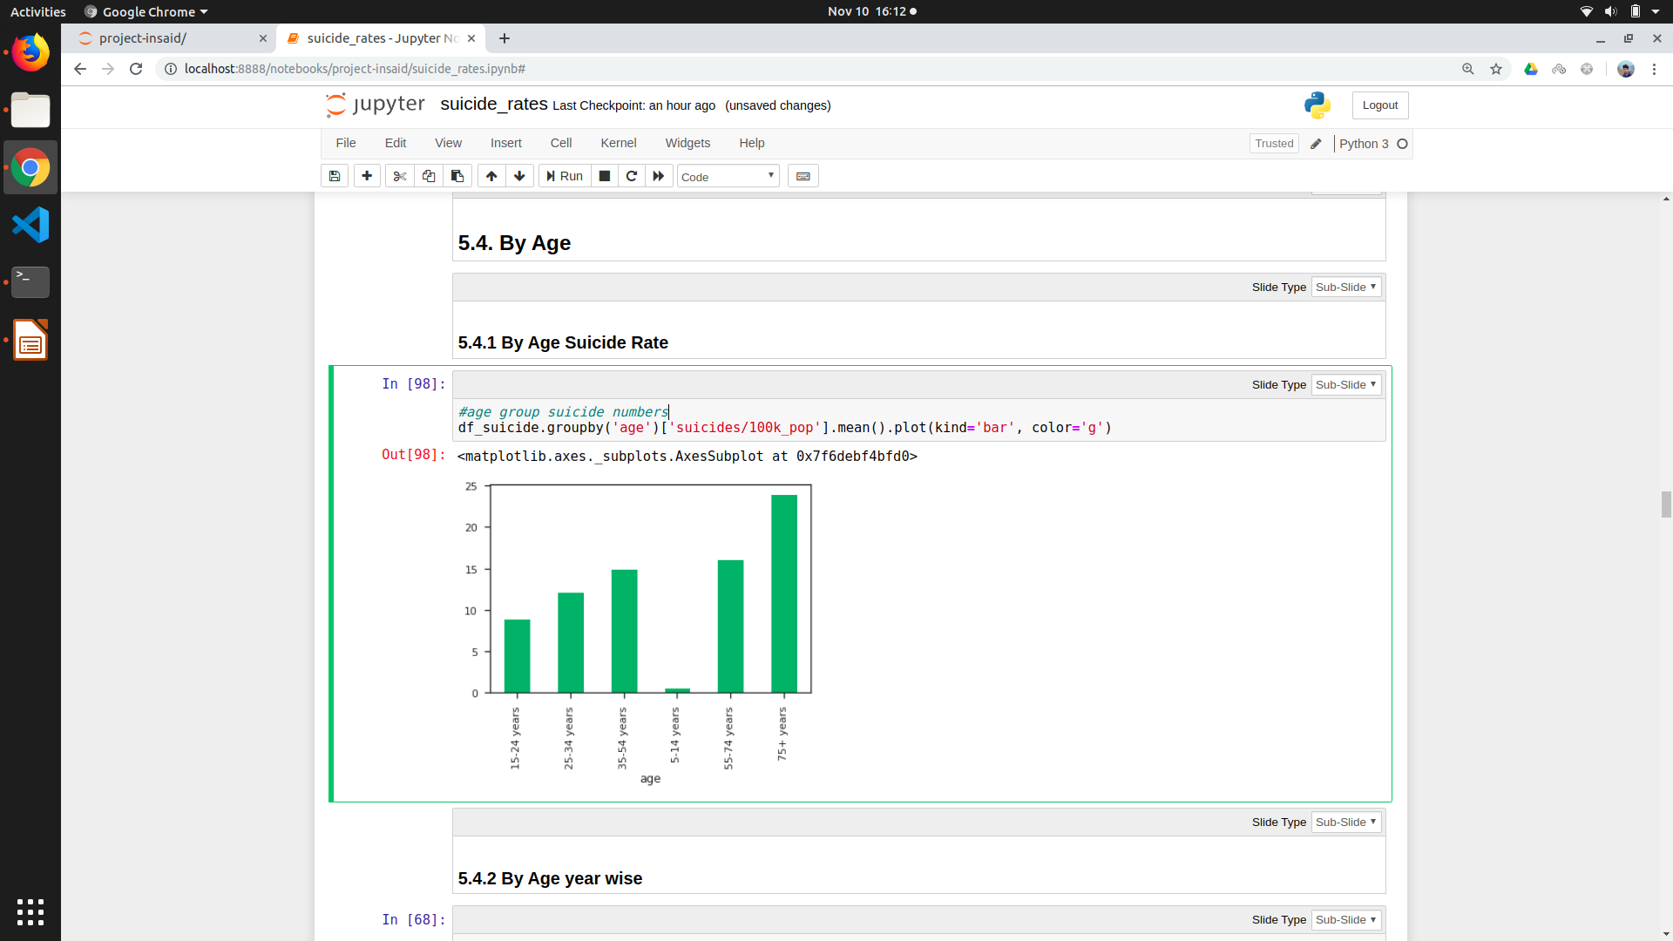
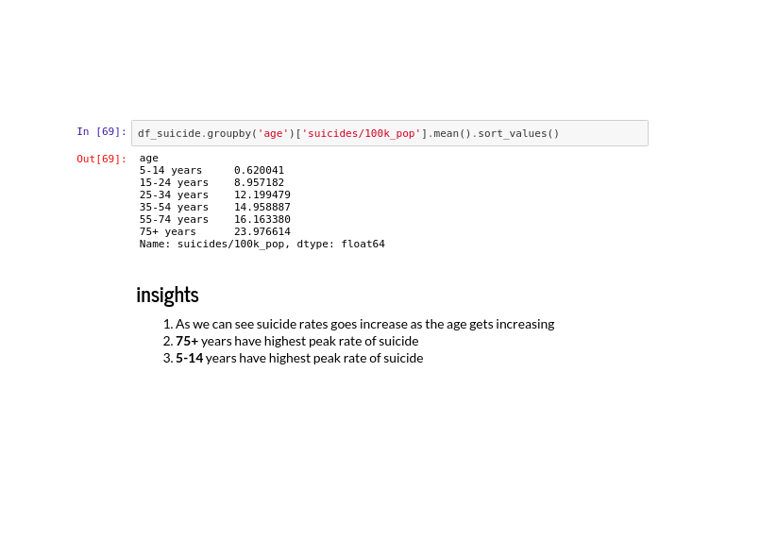
Suicide rate for age group
insights
- As we can see suicide rates goes increase as the age gets increasing
- 75+ years have highest peak rate of suicide
- 5-14 years have lowest peak rate of suicide

Slide 10
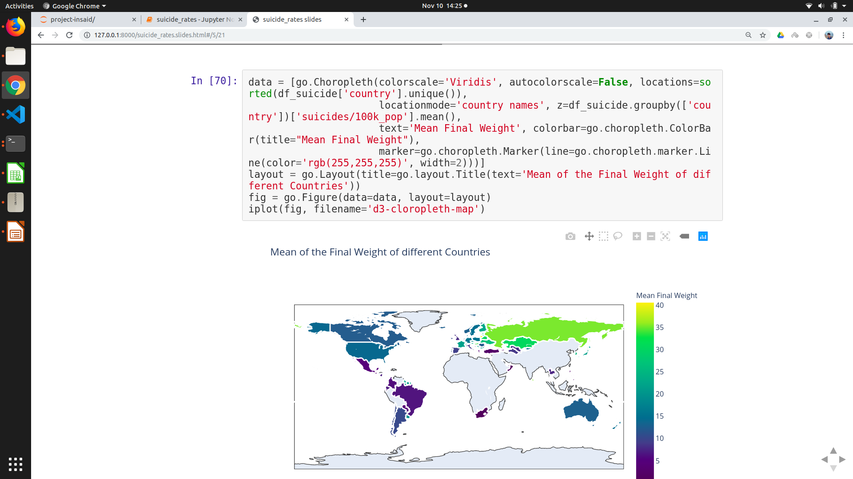
By Country wise
Insights 1. Lithuania’s rate has been highest by a large margin: > 41 suicides per 100k (per year) 2. Large overrepresentation of European countries with high rates, few with low rates

Slide 11
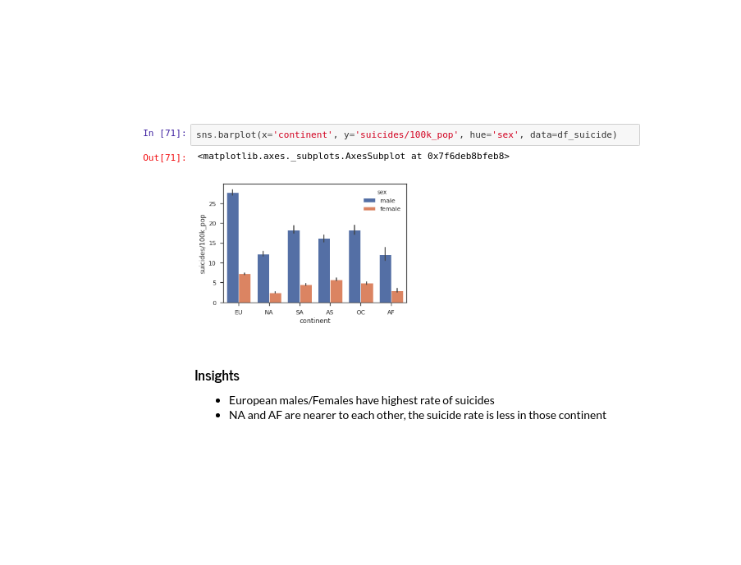
Suicide rate per continent by gender

Slide 12
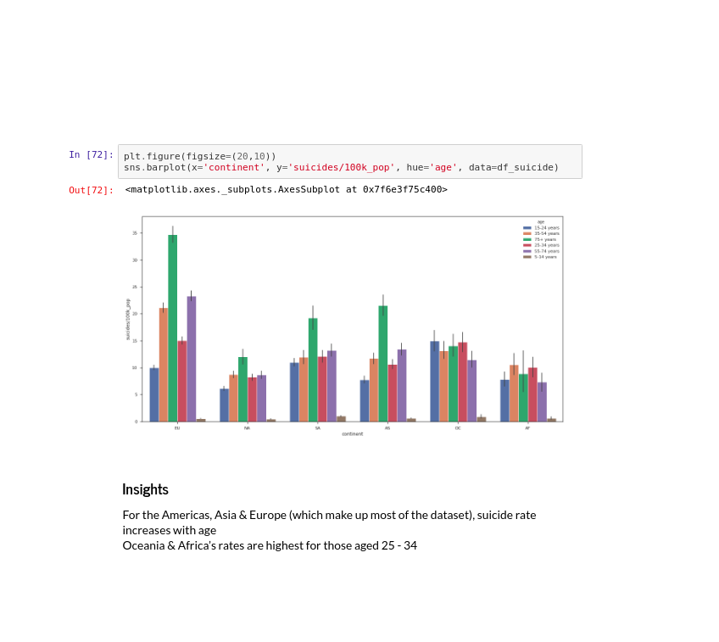
Suicide rate per continent by age

Slide 13
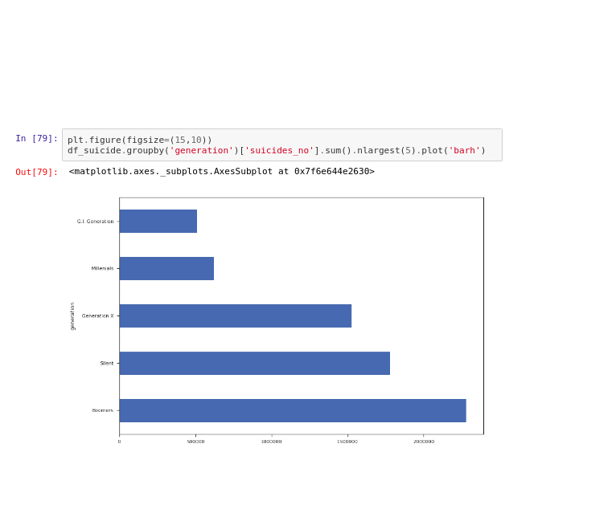
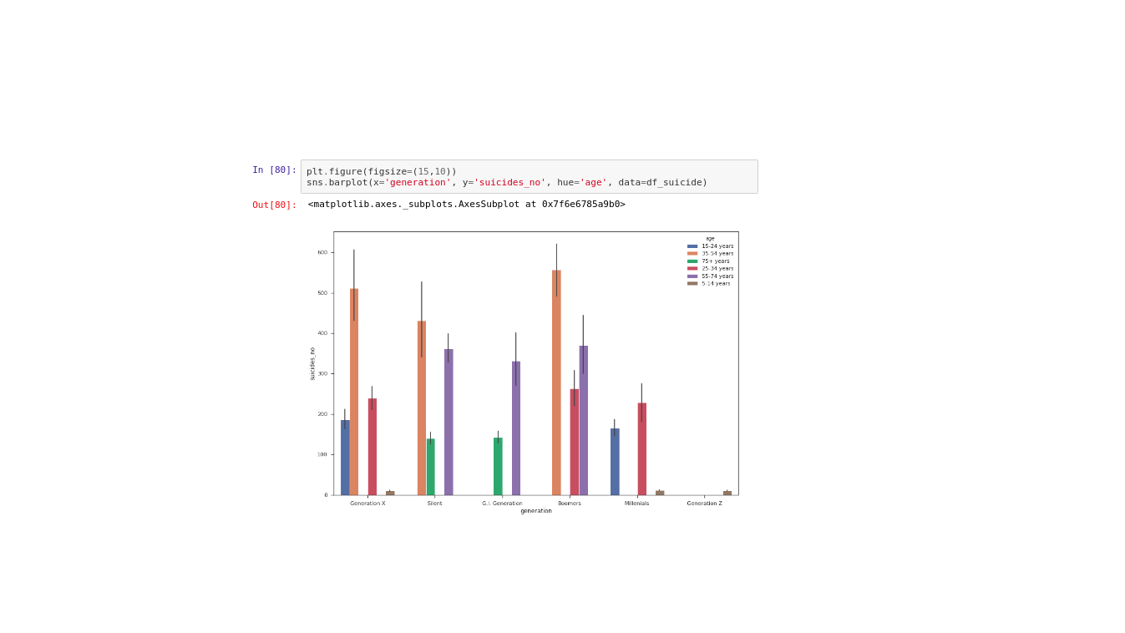
Suicide number for generation by age

Slide 14
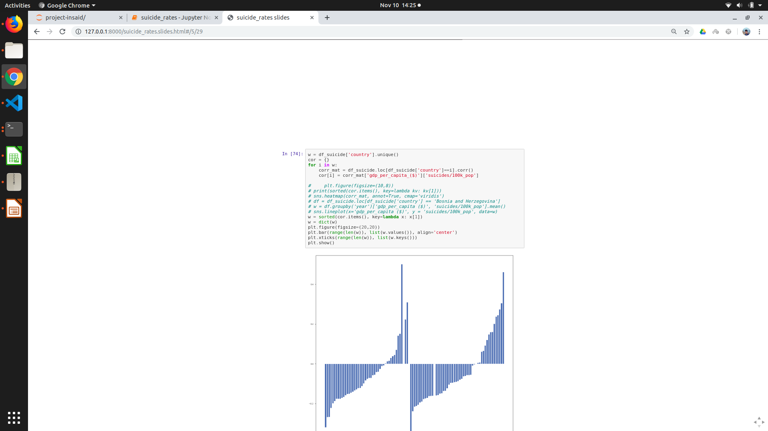
does GDP affects suicide rate?
Insights - as the GDP grows suicide rate is increasing(Bosnia) and decreasing in some countries like Barbados
y-axis:Correlation of each country with gdp and suicide rate
X-axis : countries

Slide 15
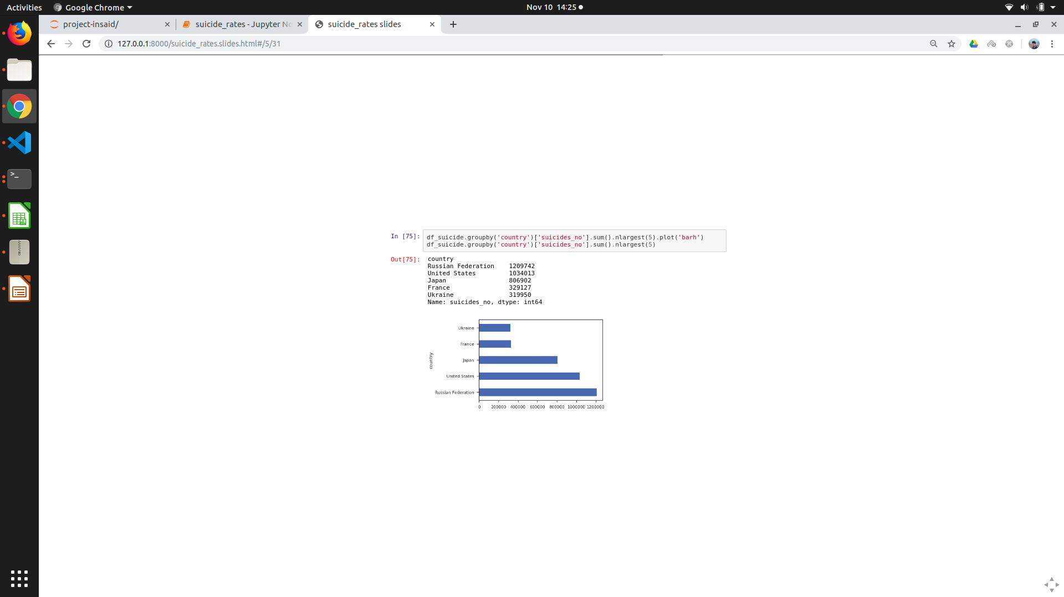
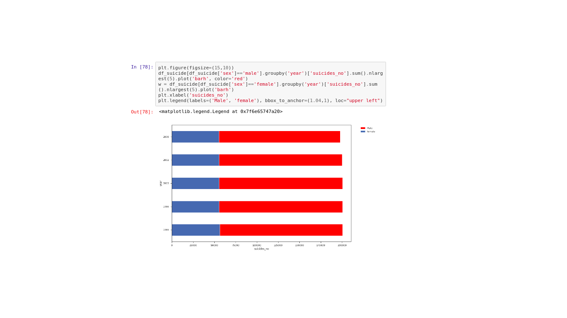
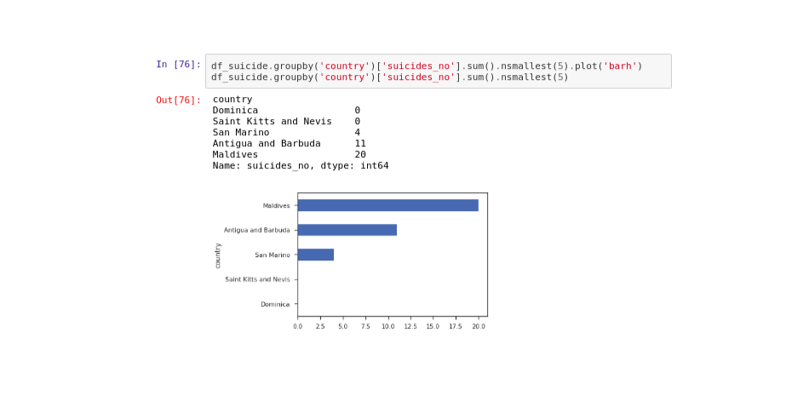
finding the five largest and smallest number of suicides numbers countrywise, year,

Slide 16
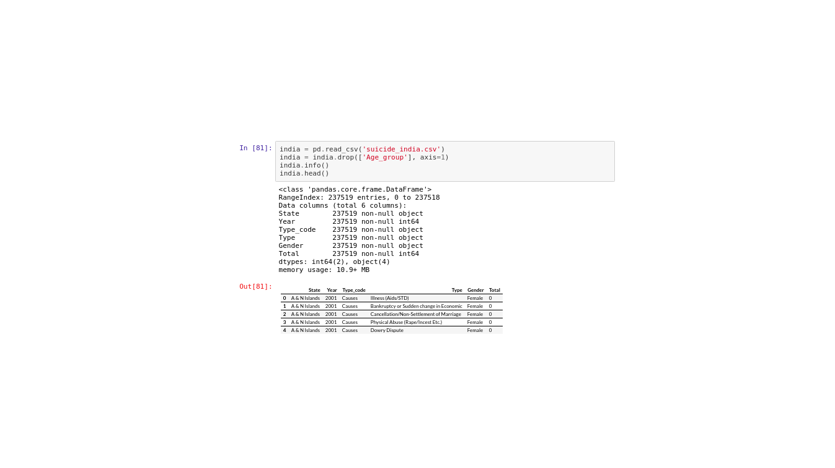
Indian suicide data (2001-2012)

Slide 17
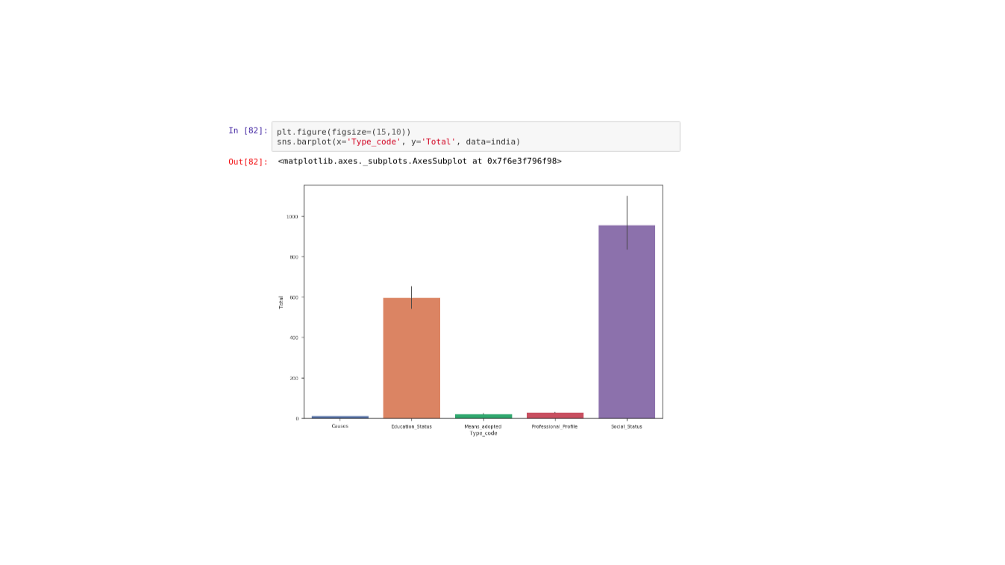
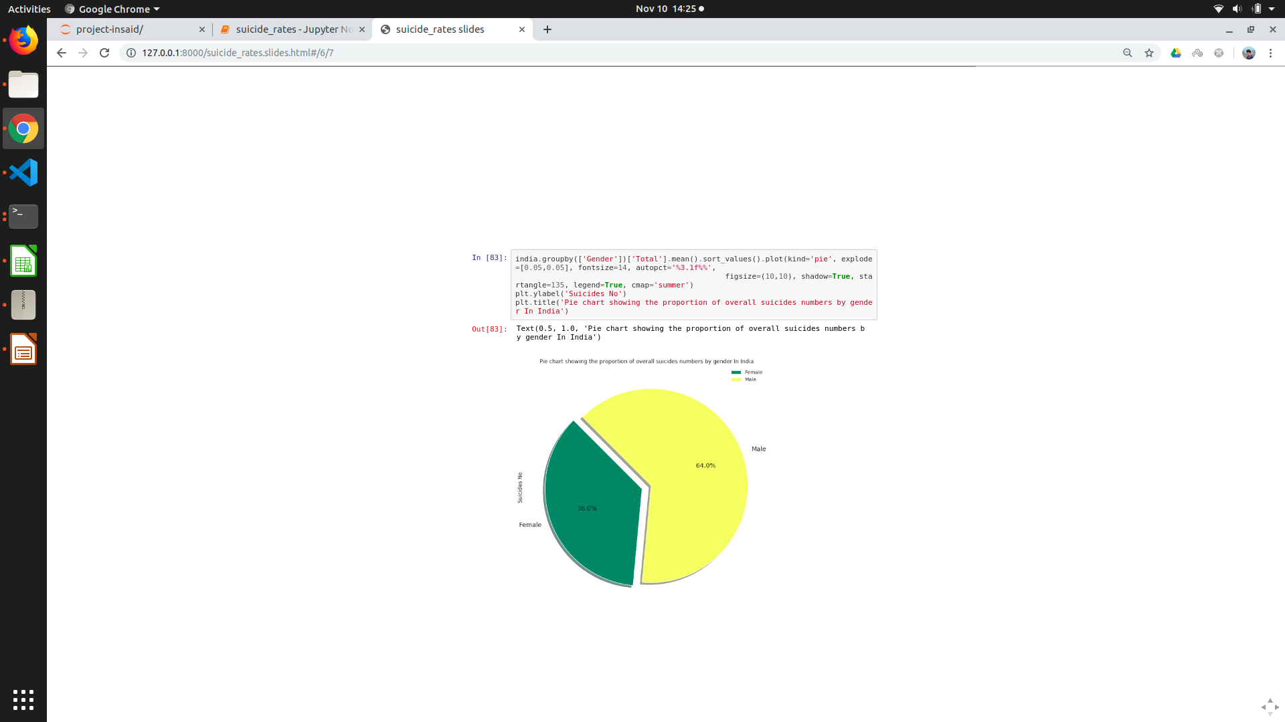
Analysis of Indian suicides with gender and cause of suicide

Slide 18
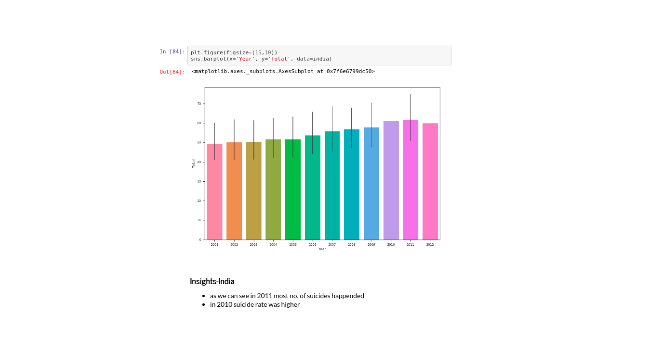
Suicide rate per year in INDIA

Slide 19
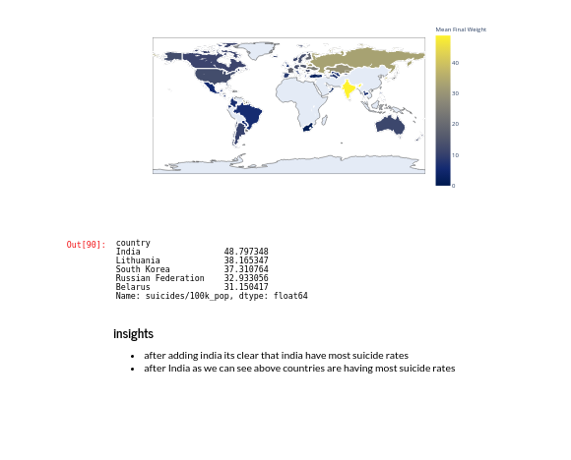
Merging the indian suicide data with world Data

Slide 20
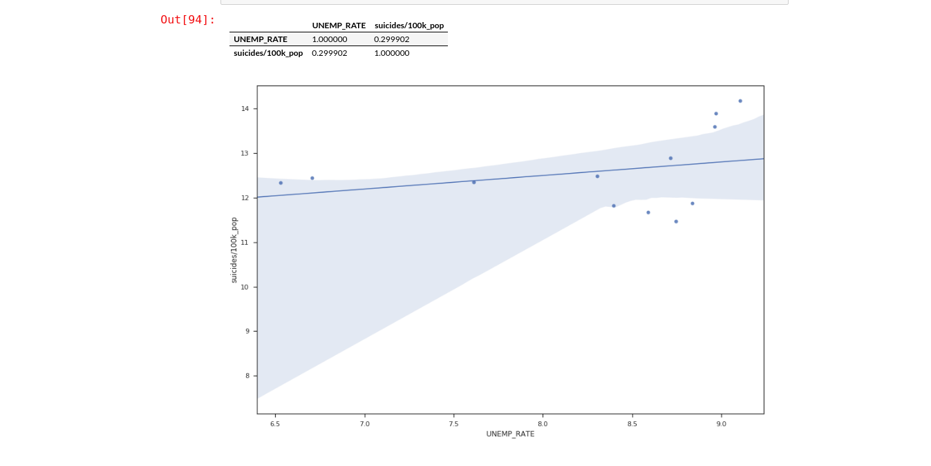
Does unemployement rate affects suicide rate?

Slide 21
Conclusion we have to focus on the below issues KEYPOINTS - 75+ year people having higher suicide rate - year by year suicide rate is increasing - gdp in some of the countries affect suicide data - male’s are having higher suicide rate. - india is having higher suicide rate - continent wise EU is having higher suicide rate
Notes:
- 75 + age

